Slide 1
Module1 1.1

Slide 2
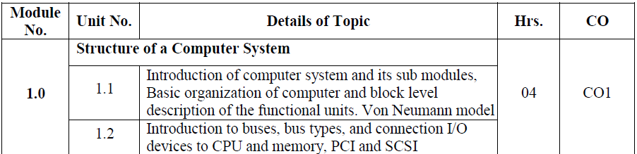

Slide 3
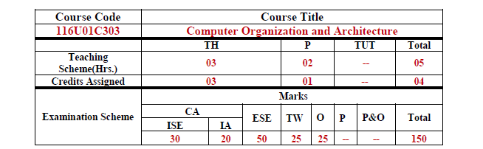

Slide 4
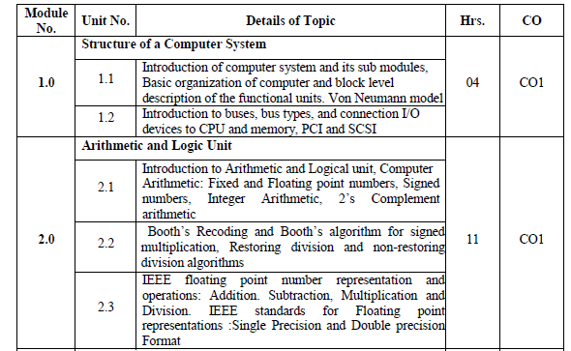

Slide 5
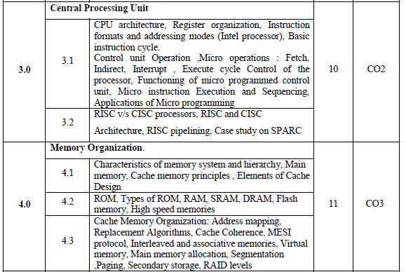

Slide 6
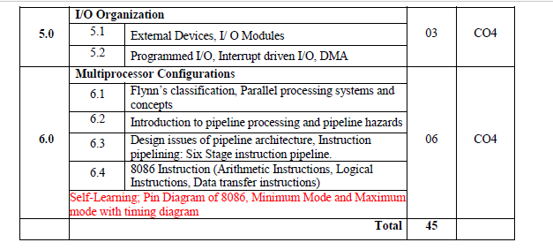

Slide 7
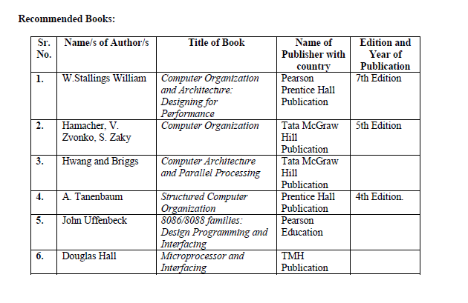

Slide 8
BASICS OF A COMPUTER
The Hardware or Basic functional units of a computer is made of electronics Circuit, and it works with electrical Signal.
Input and Output to a computer is in the form of Electrical signals.
Electrical Signal is of two types.
1. Analog-Continuous in Nature
2. Digital-Discrete in Nature
Present day computers are Digital Devices.

Slide 9
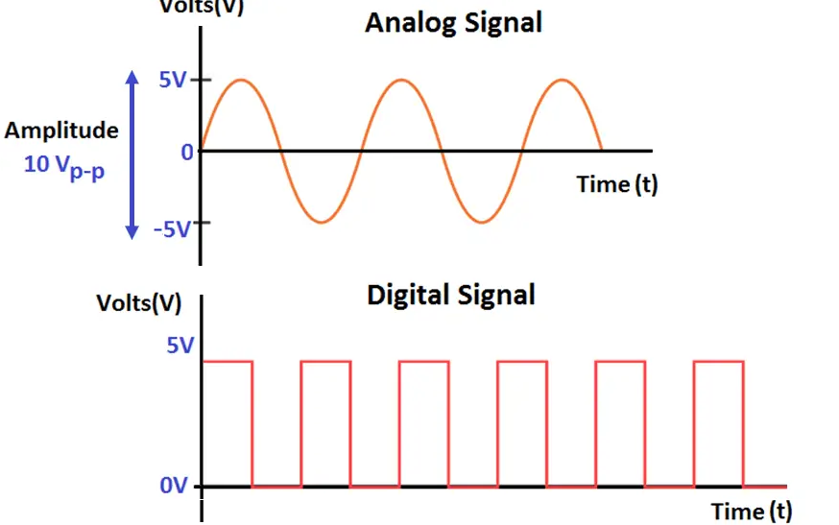
Two types Of Electrical Signal

Slide 10
COMPUTER-A Digital Device
Computer is a digital Device ,Which works on two discrete levels of signals. HIGH & LOW.
HIGH corresponds to 5 or 12 V
Low Level Corresponds to 0 V.
This volts have to be represented in symbolic representation to solve many numerical problems.
‘0’ represents LOW
‘1’ represents HIGH

Slide 11
COMPUTER-A Digital Device
So all functions of the Computer are captured using 0’s & 1’s.
The MATHEMATICAL System with 0 & 1 is called Binary number System.
The algebra based on the two valued binary system is called BOOLEAN Algebra.
So all the information in the computer is represented using strings of zeros & Ones.
The smallest unit of Information , that is represented in a computer is known as bit(Either 0 or 1).
Four bits called Nibble.
Eight bits called Byte.

Slide 12
INTRODUCTION OF COMPUTER AND ITS SUB MODULES

Slide 13
Three Basic Units Of a Computer
The Basic model of a computer –Described by THREE basic Units.
1.Central processing
2.Memory Unit
3.I/O Unit

Slide 14
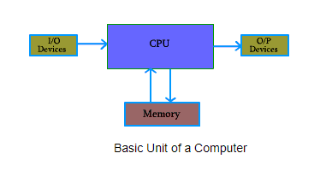

Slide 15
CPU
Consists of Two Blocks:-
1.ALU(Arithmetic Logic Unit)
2.CU (Control Unit)

Slide 16
INPUT/OUTPUT UNIT ( I/O)
It comprises the Input Block and Output Block.
I/P Unit-used to read data into the Computer.
Eg:-keyboard, Mouse..
O/P Unit-Used to Display results to the User.
Eg:-Printer,Plotter,Monitor…

Slide 17
MEMORY UNIT
Used to store the Data and programme.
This memory is called Primary memory.-
It’s the main memory with which computer works.
It includes 2 types-
----Volatile & Non-Volatile.(RAM & ROM)
Secondary memory-The memory which is non-volatile and used for permanent storage of data and programme.
Eg-pendrive, CD-Rom..

Slide 18
COMPUTER ORGANIZATION & ARCHITECTURE
In this course, We mainly deal with this Innovation in Computer Design.
This includes many aspects like-
1.Instruction set Design
2.Functional Organization
3.Logic Design &Implementation
When we go into the depth of computer design ,the terms Computer Organization & Computer Architecture are important.

Slide 19
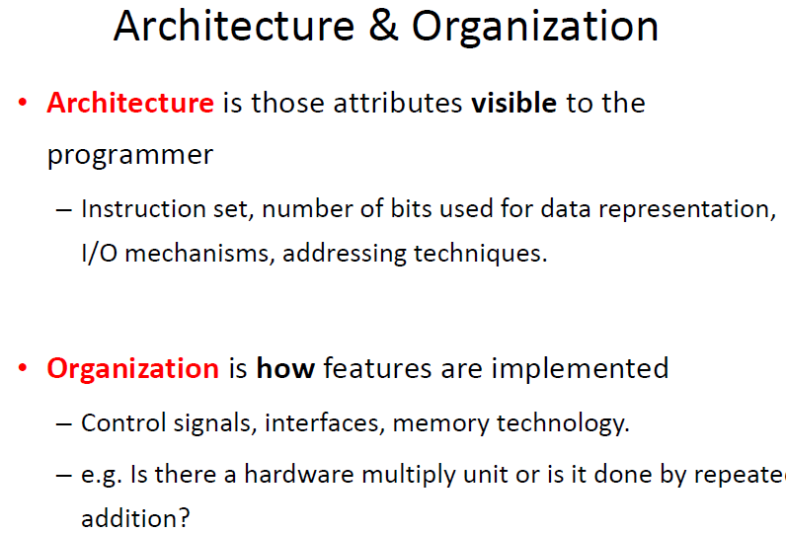
ARCHITECTURE & ORGANIZATION

Slide 20
ARCHITECTURE & ORGANIZATION
Computer Architecture-Those attributes that have a direct impact on logical execution of a program.
It can also be called Instruction Set Architecture.
Computer organization-Refers to the operational units and their interconnections that realize the architectural specifications.

Slide 21
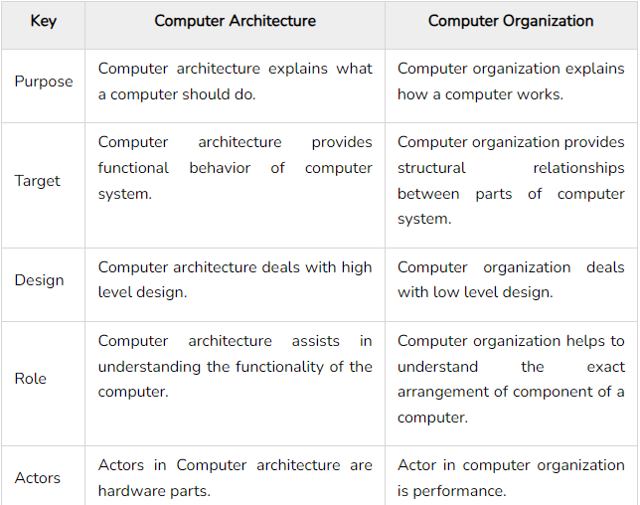
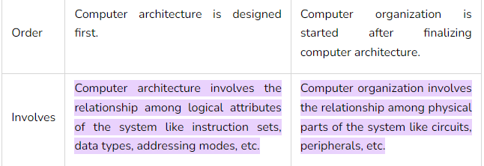

Slide 22
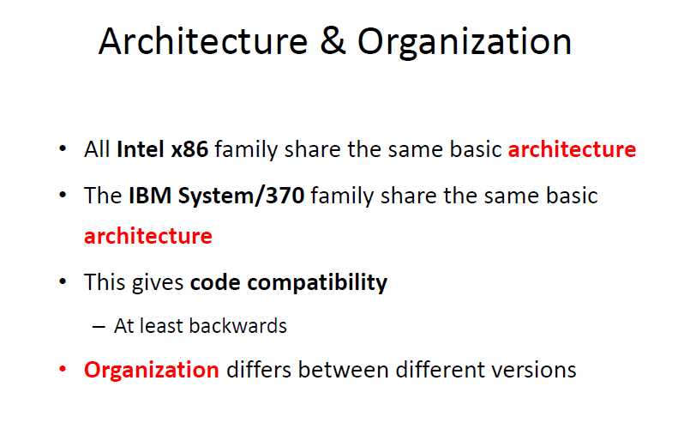

Slide 23
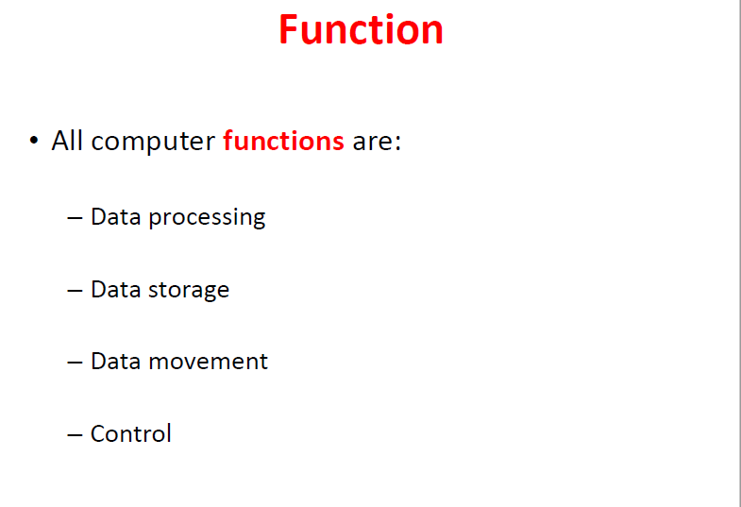

Slide 24
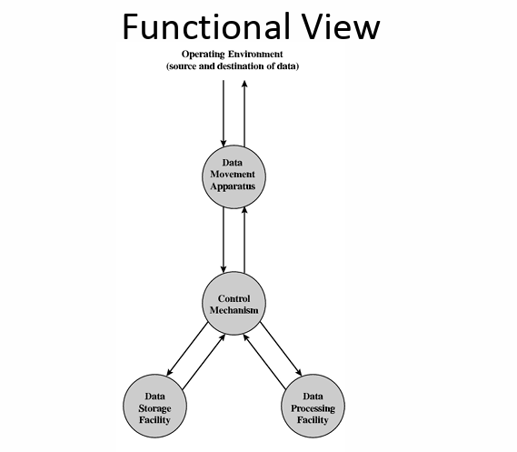

Slide 25
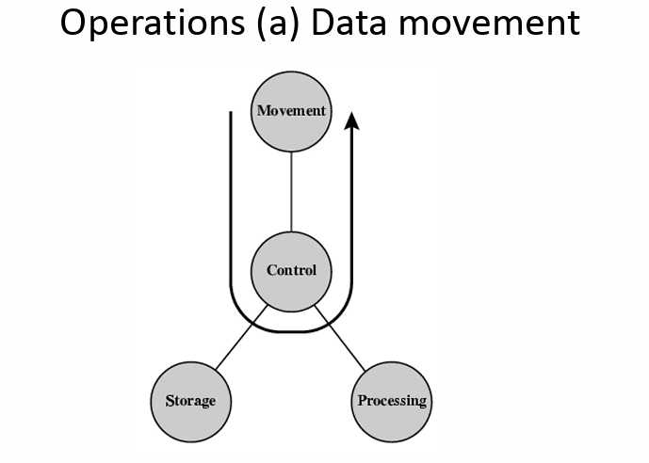

Slide 26
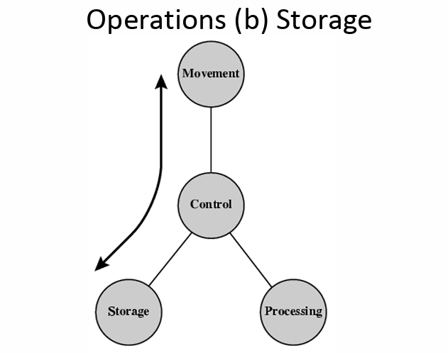

Slide 27
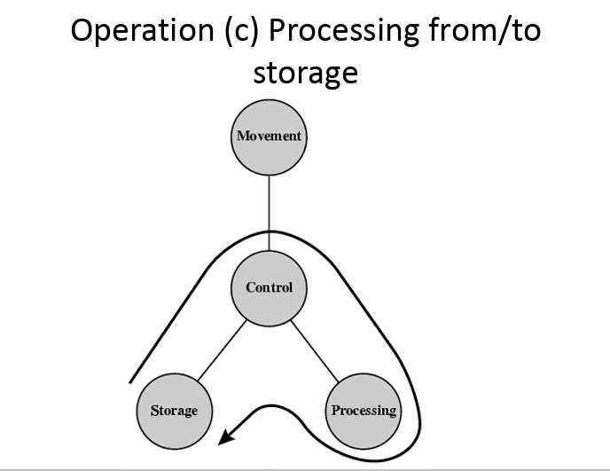

Slide 28
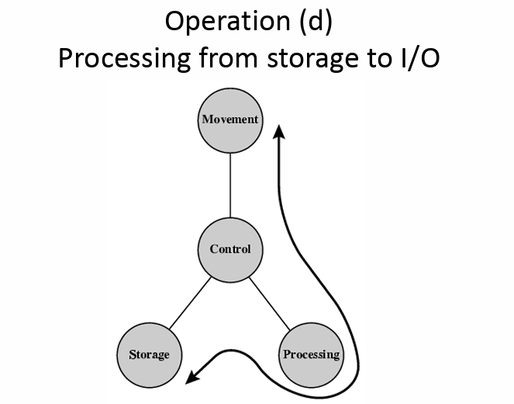

Slide 29
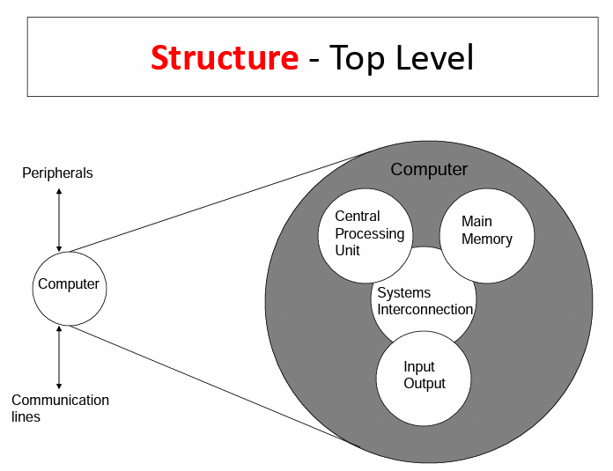

Slide 30
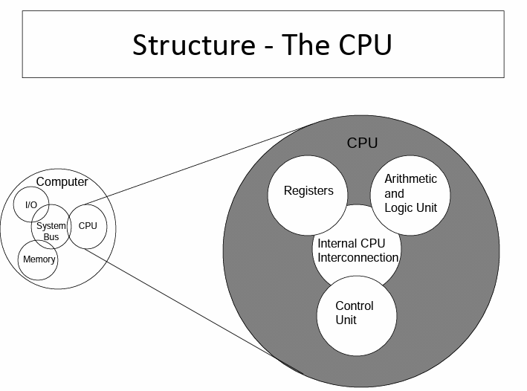

Slide 31
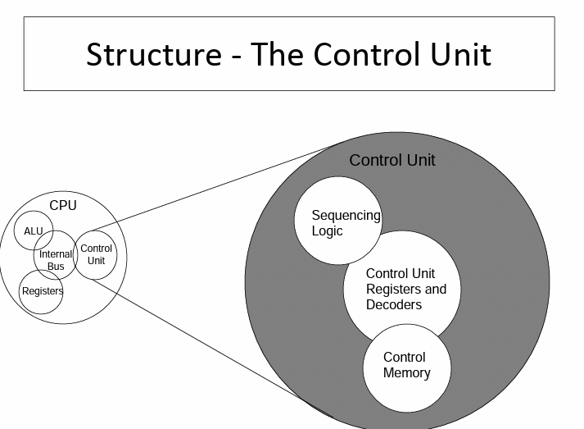

Slide 32
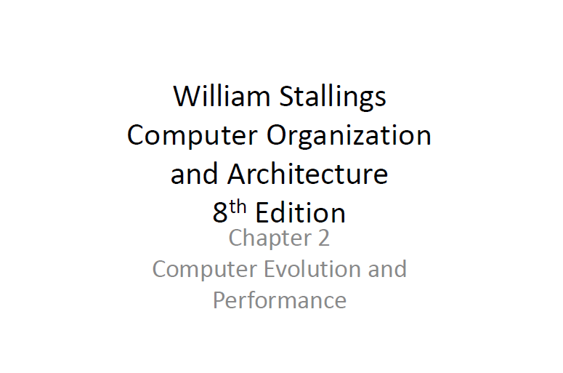

Slide 33
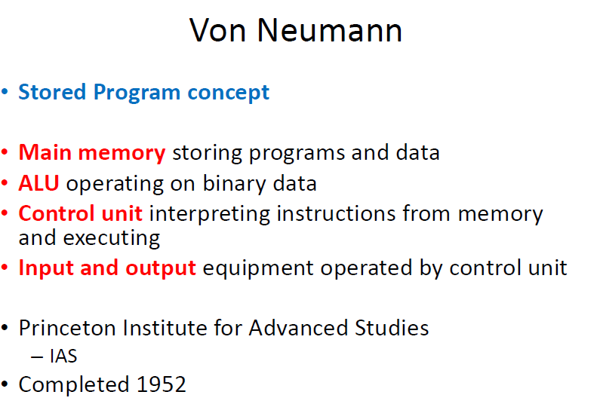

Slide 34
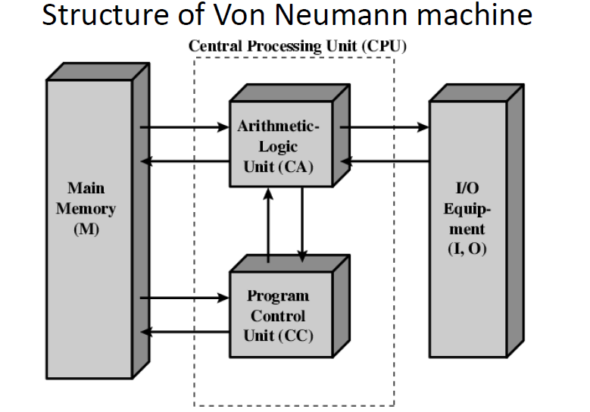

Slide 35
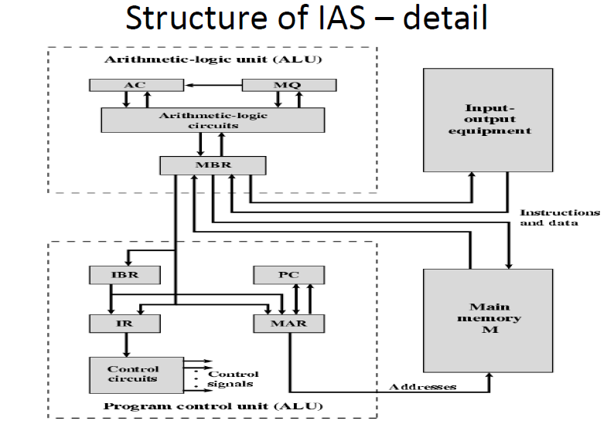

Slide 36
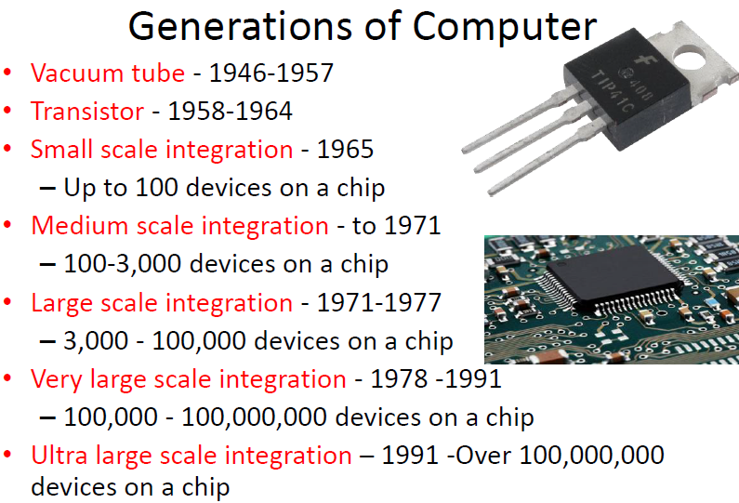

Slide 37
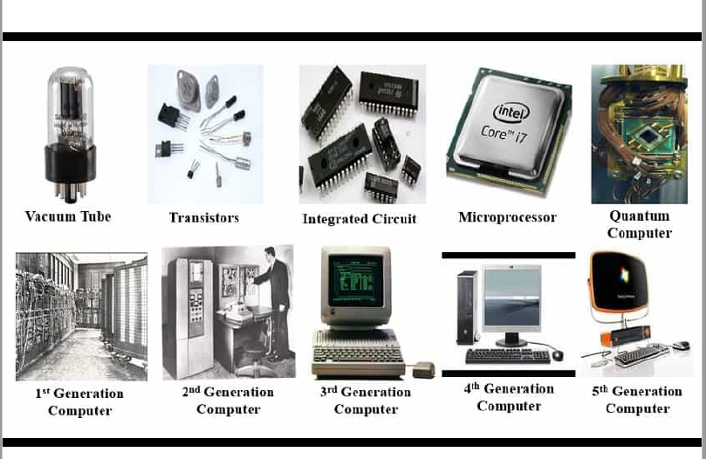

Slide 38
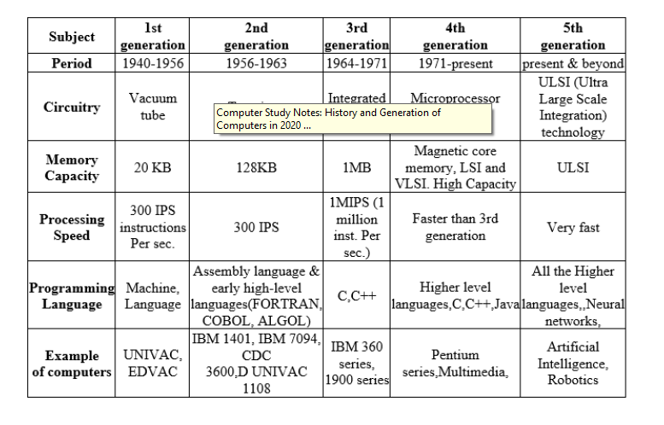

Slide 39
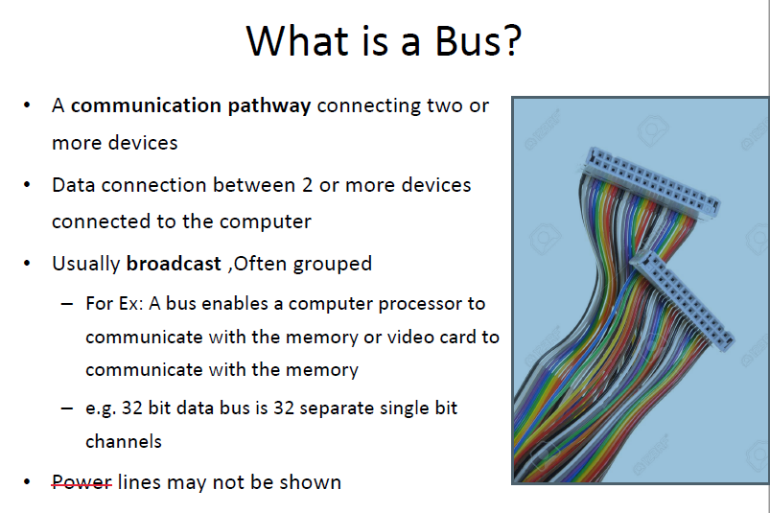

Slide 40
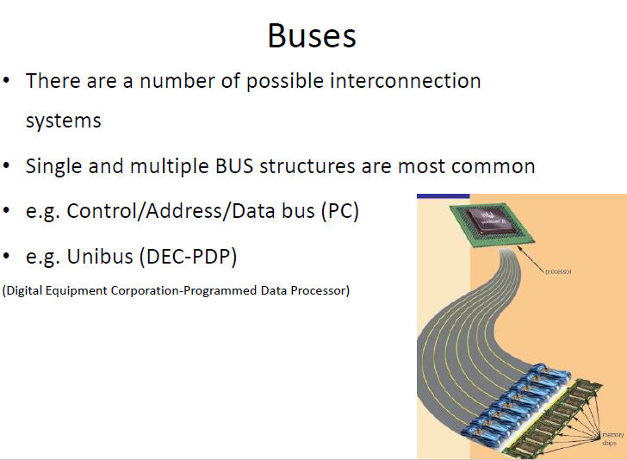

Slide 41
PCI BUS
The peripheral component interconnect (PCI) is a popular high-bandwidth, processor-independent bus that can function as a mezzanine or peripheral bus.
PCI:-
It provides interconnection between computer and its peripherals.
1.Delivers better system performance for high-speed I/O subsystems.
2.Current standard allows the use of up to 64 data lines at 66 MHz, for a transfer rate of 528 M Byte/s.
.

Slide 42
PCI BUS
3.Requires very few chips to implement and supports other buses attached to the PCI bus.
4. Support a variety of microprocessor-based configurations, including both single- and multiple-processor systems.
5 Makes use of synchronous timing and a centralized arbitration scheme.

Slide 43
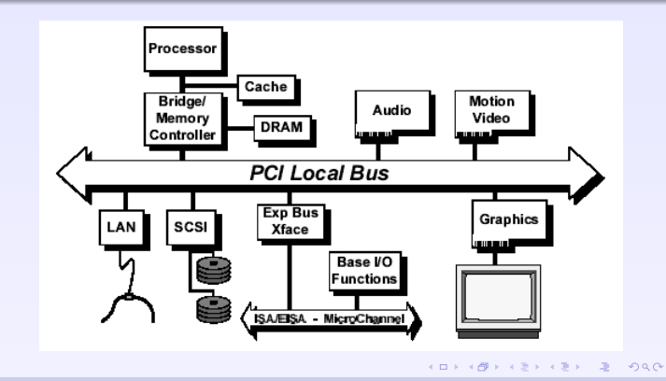

Slide 44
PCI BUS
The bridge to the PCI bus provides tight coupling with the processor and the ability to deliver data at high speeds.
PCI bridge supports communication between Host, Main memory and other peripherals(I/O devices).
The use of bridges keeps the PCI independent of the processor speed yet provides the ability to receive and deliver data rapidly.

Slide 45
BUS STRUCTURE
PCI may be configured as a 32- or 64-bit bus.
The 49 mandatory signal lines for PCI:-
System pins: Include the clock and reset pins.
Address and data pins: Include 32 lines that are time multiplexed for addresses and data. The other lines in this group are used to interpret and validate the signal lines that carry the addresses and data.
Interface control pins: Control the timing of transactions and provide coordination among initiators and targets.

Slide 46
BUS STRUCTURE
Arbitration pins: Unlike the other PCI signal lines, these are not shared lines. Rather, each PCI master has its own pair of arbitration lines that connect it directly to the PCI bus arbiter.
Error reporting pins: Used to report parity and other errors.
.

Slide 47
BUS STRUCTURE
In addition, the PCI specification defines 51 optional signal lines divided into the following functional groups:
Interrupt pins: These are provided for PCI devices that must generate requests for service. As with the arbitration pins, these are not shared lines. Rather, each PCI device has its own interrupt line or lines to an interrupt controller.
Cache support pins: These pins are needed to support a memory on PCI that can be cached in the processor or another device. These pins support snoopy cache protocols (see Chapter 18 for a discussion of such protocols).

Slide 48
BUS STRUCTURE
64-bit bus extension pins: Include 32 lines that are time multiplexed for addresses and data and that are combined with the mandatory address/data lines to form a 64-bit address/data bus. Other lines in this group are used to interpret and validate the signal lines that carry the addresses and data. Finally, there are two lines that enable two PCI devices to agree to the use of the 64-bit capability.
JTAG/boundary scan pins: These signal lines support testing procedures .

Slide 49
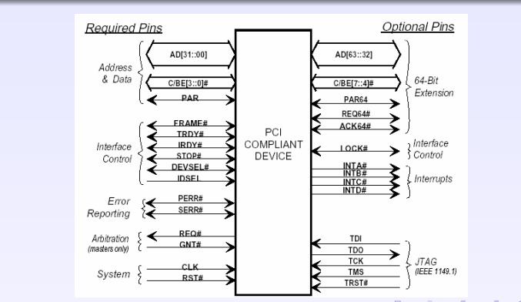
PCI Interface Signals

Slide 50
PCI Commands
Bus activity occurs in the form of transactions between an initiator, or master, and a target. When a bus master acquires control of the bus, it determines the type of transaction that will occur next.
The commands are as follows:-
Interrupt Acknowledge
Special Cycle
I/O Read
I/O Write
Memory Read
Memory Read Line

Slide 51
PCI Commands
Memory Read Multiple
Memory Write
Memory Write and Invalidate
Configuration Read
Configuration Write
Dual address Cycle

Slide 52
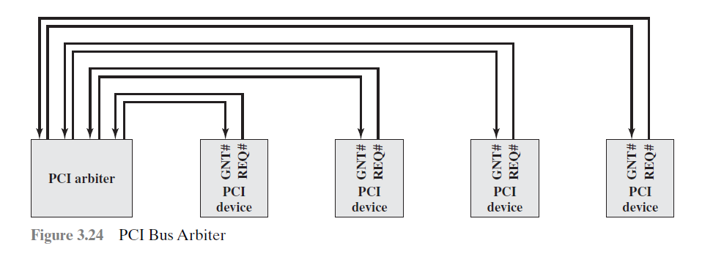
PCI ARBITRATION
PCI makes use of a centralized, synchronous arbitration scheme in which each master has a unique request (REQ) and grant (GNT) signal.

Slide 53
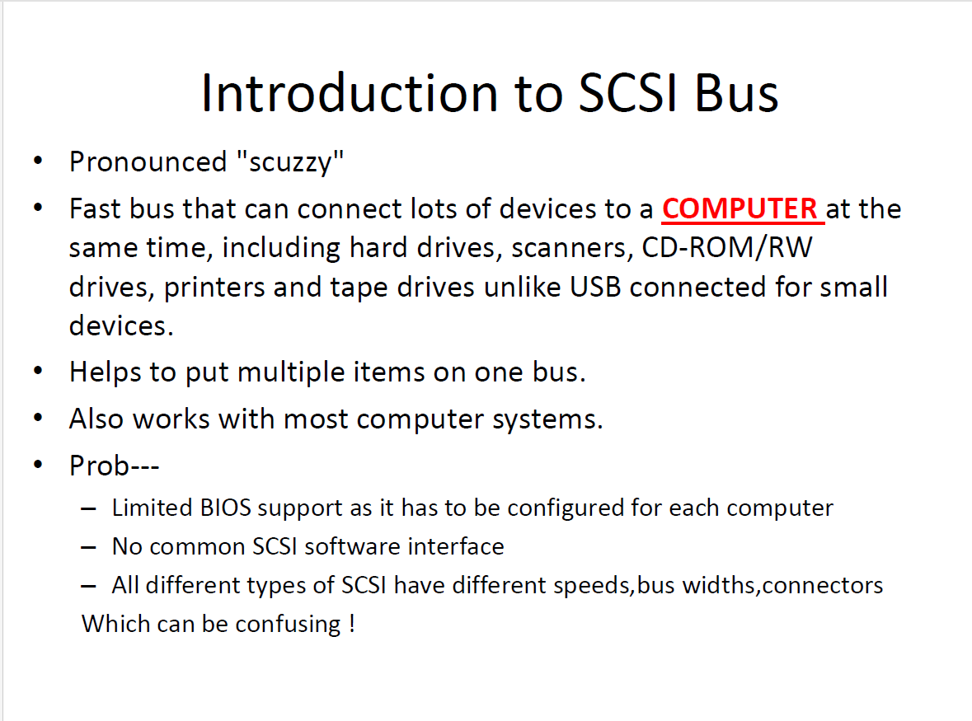
SCSI

Slide 54
SCSI
Small Computer S/M Interface –Universal paralell interface for micro computers ,to link multiple peripheral devices on a single I/O bus.
Each Device is allotted an address.
50 pin ribbon cable used to connect internal SCSI deices & thick shielded cable for connecting external SCSI devices.
The subsystems on SCSI bus function in two different ways.
Initiator & Target
Initiator-Starts communicating with the target.
Target-Responds to command from the initiator.
SCSI adaptor-initiator & peripheral Devices-Target

Slide 55
SCSI
The SCSI bus uses a handshaking protocol.
SCSI interface mainly used in servers and RISC systems.
3 Different types of SCSI standards.:-
1.SCSI-1
2.SCSI-2
3.SCSI-3
In the SCSI , one device can communicate with another in general,.
But a device may not have the capability to initiate a communication.

Slide 56
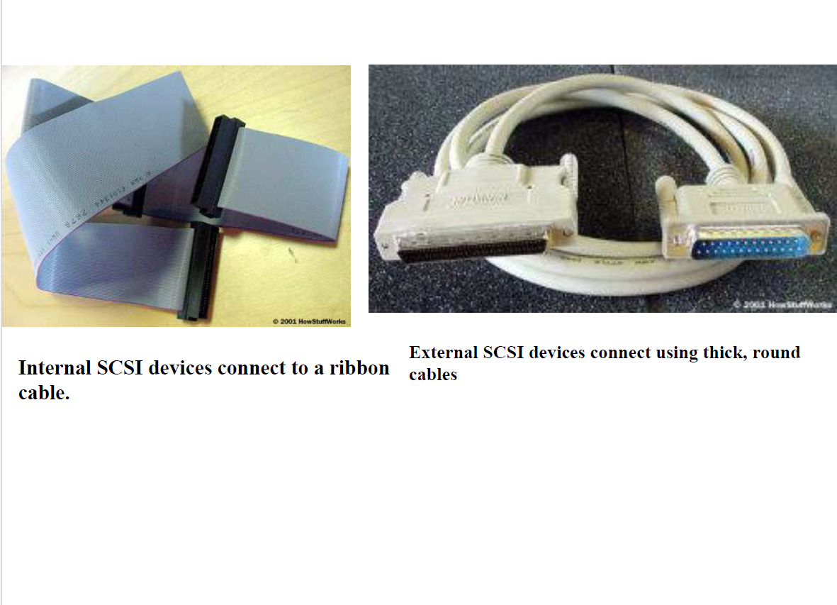
SCSI

Slide 57
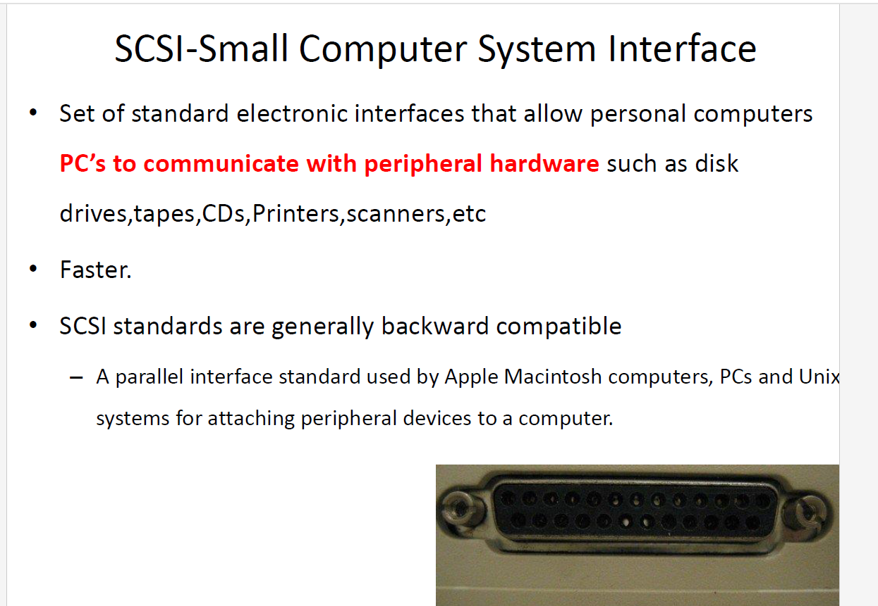

Slide 58
SCSI -1
Main feature-Supporting different I/O devices on one interface.
Upto 8 Devices can be attached.
3 bit address is used. So 8 devices are assigned address with 3 bit.
Device with address 7 has highest priority and with address 0 , lowest priority.

Slide 59
SCSI-2
Introduced to support devices like CD-ROM’s ,Scanners,Communication devices & Optical Storage Devices.
It supports 8-bit, 16 bit or 32 bit data.
Its different versions are:-
1.Fast SCSI
Wide SCSI
Fast and wide
Slow and normal

Slide 60
SCSI_3
Supports more than 8 eight devices and transfer speed is 20 MBPS.
Main objective-To support Optical fiber and long distance.
Upto 16 devices can be connected on such a SCSI bus.

Slide 61
SCSI BUS PRINCIPLES
Supports variety of peripherals such as disk drives, tape drives…
SCSI provides peer-peer protocol(2 devices can communicate on equal levels to perform I/O activities.
A maximum of 8 SCSI devices are permitted even though only 2 can communicate at a time.
The SCSI bus is time shared to achieve effective utilization of bus bandwidth.
Hence the devices disconnect and reconnect the bus as and when required.
When 2 devices communicate on bus –one acts as initiator and other target.

Slide 62
SCSI BUS PRINCIPLES
Information transfers on the data bus are asynchronous and follow a handshake protocol.
One byte of information is transferred with each handshake.
Synchronous data transfer option is also possible.
Reference_ B.Govinda Rajalu-Computer oraganization & architecture

